Slide 1
Network Security
Chapter 7 – “ “Pseudorandom Number Generation and Stream Ciphers”

Slide 2
Traffic Padding
With the use of link encryption, packet headers are encrypted, reducing the opportunity for traffic analysis. However, it is still possible in those circumstances for an attacker to assess the amount of traffic on a network and to observe the amount of traffic entering and leaving each end system. An effective countermeasure to this attack is traffic padding.
Traffic padding is a function that produces ciphertext output continuously, even in the absence of plaintext. A continuous random data stream is generated. When plaintext is available, it is encrypted and transmitted. When input plaintext is not present, the random data are encrypted and transmitted. This makes it impossible for an attacker to distinguish between true data flow and noise and therefore impossible to deduce the amount of traffic.
Notes:
We mentioned that, in some cases, users are concerned about security from traffic analysis. With the use of link encryption, packet headers are encrypted, reducing the opportunity for traffic analysis. However, it is still possible in those circumstances for an attacker to assess the amount of traffic on a network and to observe the amount of traffic entering and leaving each end system. An effective countermeasure to this attack is traffic padding.
Traffic padding is a function that produces ciphertext output continuously, even in the absence of plaintext. A continuous random data stream is generated. When plaintext is available, it is encrypted and transmitted. When input plaintext is not present, the random data are encrypted and transmitted. This makes it impossible for an attacker to distinguish between true data flow and noise and therefore impossible to deduce the amount of traffic.

Slide 3
Random Numbers
many uses of random numbers in cryptography
  Nonces in authentication protocols to prevent replay
  session keys
  public key generation
  keystream for a one-time pad
in all cases its critical that these values be
  statistically random, uniform distribution, independent
  unpredictability of future values from previous values
Notes:
Random numbers play an important role in the use of encryption for various network security applications. Getting good random numbers is important, but difficult. You don‘t want someone guessing the key you're using to protect your communications because your "random numbers" weren't (as happened in an early release of Netscape SSL). Need such random values to be both statistically random (with uniform distribution & independent) and also to be unpredictable (so that it is not possible to predict future values having observed previous values).

Slide 4
Pseudorandom Number Generators (PRNGs)
often use deterministic algorithmic techniques to create “random numbers”
  although are not truly random
  can pass many tests of “randomness”
known as “pseudorandom numbers”
Notes:
Cryptographic applications typically make use of deterministic algorithmic techniques for random number generation, producing sequences of numbers that are not statistically random, but if the algorithm is good, the resulting sequences will pass many reasonable tests of randomness. Such numbers are referred to as pseudorandom numbers, created by “Pseudorandom Number Generators (PRNGs)”.

Slide 5
Linear Congruential Generator
common iterative technique using:
  X_{n+1} = (aX_{n} + c) mod m
given suitable values of parameters can produce a long random-like sequence
suitable criteria to have are:
  function generates a full-period
  generated sequence should appear random
  efficient implementation with 32-bit arithmetic
note that an attacker can reconstruct sequence given a small number of values
have possibilities for making this harder
Notes:
By far the most widely used technique for pseudorandom number generation is the “Linear Congruential Generator”, first proposed by Lehmer. It uses successive values from an iterative equation. Given suitable values of parameters can produce a long random-like sequence, but there are only a small number of such good choices. Note that the sequence, whilst looking random, is highly predictable, and an attacker can reconstruct the sequence knowing only a small number of values. There are some approaches to making this harder to do in practice by modifying the numbers in some way, see text.

Slide 6
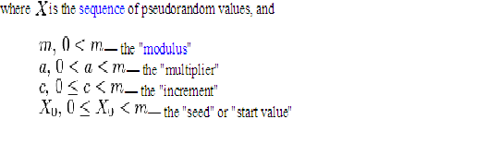

Slide 7
ANSI(American National Standards Institute) X9.17 PRG
One of the strongest (cryptographically speaking) PRNGs is specified in ANSI X9.17. It uses date/time & seed inputs and 3 triple-DES encryptions to generate a new seed & random value. See discussion & illustration in Stallings section 7.4 & Figure 7.14 where:
DTi - Date/time value at the beginning of ith generation stage
Vi - Seed value at the beginning of ith generation stage
Ri - Pseudorandom number produced by the ith generation stage
K1, K2 - DES keys used for each stage
Then compute successive values as:
Ri = EDE([K1, K2], [Vi XOR EDE([K1, K2], DTi)])
Vi+1 = EDE([K1, K2], [Ri XOR EDE([K1, K2], DTi)])

Slide 8
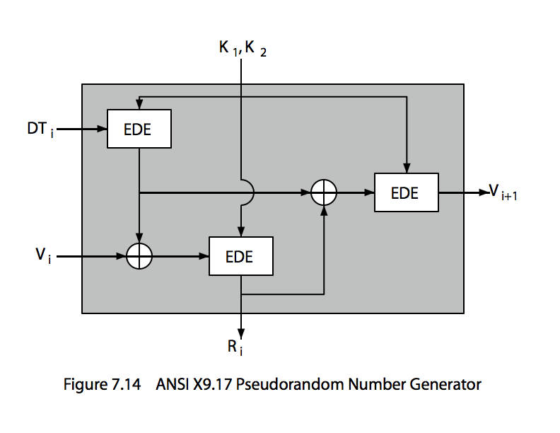
ANSI X9.17 PRG
Notes:
One of the strongest (cryptographically speaking) PRNGs is specified in ANSI X9.17. It uses date/time & seed inputs and 3 triple-DES encryptions to generate a new seed & random value. See discussion & illustration in Stallings section 7.4 & Figure 7.14 where:
DTi - Date/time value at the beginning of ith generation stage
Vi - Seed value at the beginning of ith generation stage
Ri - Pseudorandom number produced by the ith generation stage
K1, K2 - DES keys used for each stage
Then compute successive values as:
Ri = EDE([K1, K2], [Vi XOR EDE([K1, K2], DTi)])
Vi+1 = EDE([K1, K2], [Ri XOR EDE([K1, K2], DTi)])
Several factors contribute to the cryptographic strength of this method. The technique involves a 112-bit key and three EDE encryptions for a total of nine DES encryptions. The scheme is driven by two pseudorandom inputs, the date and time value, and a seed produced by the generator that is distinct from the pseudo-random number produced by the generator. Thus the amount of material that must be compromised by an opponent is overwhelming.

Slide 9
Chapter 8 – Introduction to Number Theory

Slide 10
Prime Numbers
prime numbers only have divisors of 1 and self
  they cannot be written as a product of other numbers
  note: 1 is prime, but is generally not of interest
eg. 2,3,5,7 are prime, 4,6,8,9,10 are not
prime numbers are central to number theory
list of prime number less than 200 is:
  2 3 5 7 11 13 17 19 23 29 31 37 41 43 47 53 59 61 67 71 73 79 83 89 97 101 103 107 109 113 127 131 137 139 149 151 157 163 167 173 179 181 191 193 197 199
Notes:
A central concern of number theory is the study of prime numbers. Indeed, whole books have been written on the subject. An integer p>1 is a prime number if and only if its only divisors are 1 and itself. Prime numbers play a critical role in number theory and in the techniques discussed in this chapter. Stallings Table 8.1 (excerpt above) shows the primes less than 2000. Note the way the primes are distributed. In particular note the number of primes in each range of 100 numbers.

Slide 11
Prime Factorisation
to factor a number n is to write it as a product of other numbers: n=a x b x c
note that factoring a number is relatively hard compared to multiplying the factors together to generate the number
the prime factorisation of a number n is when its written as a product of primes
  eg. 91=7x13 ; 3600=2⁴x3²x5²
Notes:
The idea of "factoring" a number is important - finding numbers which divide into it. Taking this as far as can go, by factorising all the factors, we can eventually write the number as a product of (powers of) primes - its prime factorisation. Note also that factoring a number is relatively hard compared to multiplying the factors together to generate the number.

Slide 12
Relatively Prime Numbers & GCD
two numbers a, b are relatively prime if have no common divisors apart from 1
  eg. 8 & 15 are relatively prime since factors of 8 are 1,2,4,8 and of 15 are 1,3,5,15 and 1 is the only common factor
conversely can determine the greatest common divisor by comparing their prime factorizations and using least powers
  eg. 300=2¹x3¹x5² 18=2¹x3² hence GCD(18,300)=2¹x3¹x5⁰=6
Notes:
Have the concept of “relatively prime” if two number share no common factors other than 1.
Another common problem is to determine the "greatest common divisor” GCD(a,b) which is the largest number that divides into both a & b.

Slide 13
Euler Totient Function ø(n)
when doing arithmetic modulo n
complete set of residues is: 0..n-1
reduced set of residues is those numbers (residues) which are relatively prime to n
  eg for n=10,
  complete set of residues is {0,1,2,3,4,5,6,7,8,9}
  reduced set of residues is {1,3,7,9}
number of elements in reduced set of residues is called the Euler Totient Function ø(n)
Notes:
Now introduce the Euler’s totient function ø(n), defined as the number of positive integers less than n & relatively prime to n. Note the term “residue” refers to numbers less than some modulus, and the “reduced set of residues” to those numbers (residues) which are relatively prime to the modulus (n). Note by convention that ø(1) = 1.

Slide 14
Euler Totient Function ø(n)
to compute ø(n) need to count number of residues to be excluded
in general need prime factorization, but
  for p (p prime) ø(p) = p-1
  for p.q (p,q prime) ø(pq) =(p-1)x(q-1)
eg.
  ø(37) = 36
  ø(21) = (3–1)x(7–1) = 2x6 = 12
Notes:
To compute ø(n) need to count the number of residues to be excluded. In general you need use a complex formula on the prime factorization of n, but have a couple of special cases as shown.

Slide 15
Euler’s totient function
Euler’s function associates to any positive integer na number φ(n): the
number of positive integers smaller than n and relatively prime to n
􀂉Example:
􀂄φ(37)=36
􀂄φ(p)=p-1, for any prime p
􀂄φ(35)=24: {1,2,3,4,6,8,9,11,12,13,16,17,18,19,22,23,24,26,27,29,31,32,33,34}
􀂉Easy to see that for any two primes p,q, φ(pq)=(p-1)(q-1)
􀂄All numbers smaller than pq are relatively primes with pq except for multiples
of p (q-1 of them) and multiples of q (p-1 of them)

Slide 16
Euler's Theorem
a generalisation of Fermat's Theorem
a^{ø(n)} = 1 (mod n)
  for any a,n where gcd(a,n)=1
eg.
  a=3;n=10; ø(10)=4;
  hence 3⁴ = 81 = 1 mod 10
  a=2;n=11; ø(11)=10;
  hence 2¹⁰ = 1024 = 1 mod 11
Notes:
Euler's Theorem is a generalization of Fermat's Theorem for any number n. See Stallings section 8.2 for its proof.

Slide 17
CHAPTER 9 – PUBLIC KEY CRYPTOGRAPHY AND RSA

Slide 18
Private-Key Cryptography
traditional private/secret/single key cryptography uses one key
shared by both sender and receiver
if this key is disclosed communications are compromised
also is symmetric, parties are equal
hence does not protect sender from receiver forging a message & claiming is sent by sender
Notes:
So far all the cryptosystems discussed have been private/secret/single key (symmetric) systems. All classical, and modern block and stream ciphers are of this form.

Slide 19
Public-Key Cryptography
probably most significant advance in the 3000 year history of cryptography
uses two keys – a public & a private key
asymmetric since parties are not equal
uses clever application of number theoretic concepts to function
complements rather than replaces private key crypto
Notes:
Will now discuss the radically different public key systems, in which two keys are used. Anyone knowing the public key can encrypt messages or verify signatures, but cannot decrypt messages or create signatures, counter-intuitive though this may seem. It works by the clever use of number theory problems that are easy one way but hard the other. Note that public key schemes are neither more secure than private key (security depends on the key size for both), nor do they replace private key schemes (they are too slow to do so), rather they complement them.

Slide 20
Public-Key Cryptography
public-key/two-key/asymmetric cryptography involves the use of two keys:
  a public-key, which may be known by anybody, and can be used to encrypt messages, and verify signatures
  a private-key, known only to the recipient, used to decrypt messages, and sign (create) signatures
is asymmetric because
  those who encrypt messages or verify signatures cannot decrypt messages or create signatures

Slide 21

Public-Key Cryptography
Notes:
Stallings Fig 9-1.

Slide 22
Why Public-Key Cryptography?
developed to address two key issues:
  key distribution – how to have secure communications in general without having to trust a KDC with your key
  digital signatures – how to verify a message comes intact from the claimed sender
public invention due to Whitfield Diffie & Martin Hellman at Stanford Uni in 1976
  known earlier in classified community
Notes:
The idea of public key schemes, and the first practical scheme, which was for key distribution only, was published in 1977 by Diffie & Hellman. The concept had been previously described in a classified report in 1970 by James Ellis (UK CESG) - and subsequently declassified in 1987. See History of Non-secret Encryption (at CESG). Its interesting to note that they discovered RSA first, then Diffie-Hellman, opposite to the order of public discovery!

Slide 23
Public-Key Characteristics
Public-Key algorithms rely on two keys with the characteristics that it is:
  computationally infeasible to find decryption key knowing only algorithm & encryption key
  computationally easy to en/decrypt messages when the relevant (en/decrypt) key is known
  either of the two related keys can be used for encryption, with the other used for decryption (in some schemes)
Notes:
Public key schemes utilise problems that are easy (P type) one way but hard (NP type) the other way, eg exponentiation vs logs, multiplication vs factoring. Consider the following analogy using padlocked boxes: traditional schemes involve the sender putting a message in a box and locking it, sending that to the receiver, and somehow securely also sending them the key to unlock the box. The radical advance in public key schemes was to turn this around, the receiver sends an unlocked box to the sender, who puts the message in the box and locks it (easy - and having locked it cannot get at the message), and sends the locked box to the receiver who can unlock it (also easy), having the key. An attacker would have to pick the lock on the box (hard).

Slide 24

Public-Key Cryptosystems
Notes:
Stallings Fig 9-4.
Here see various components of public-key schemes used for both secrecy and authentication. Note that separate key pairs are used for each of these – receiver owns and creates secrecy keys, sender owns and creates authentication keys.

Slide 25
Public-Key Applications
can classify uses into 3 categories:
  encryption/decryption (provide secrecy)
  digital signatures (provide authentication)
  key exchange (of session keys)
some algorithms are suitable for all uses, others are specific to one

Slide 26
RSA
by Rivest, Shamir & Adleman of MIT in 1977
best known & widely used public-key scheme
based on exponentiation in a finite (Galois) field over integers modulo a prime
  nb. exponentiation takes O((log n)³) operations (easy)
uses large integers (eg. 1024 bits)
security due to cost of factoring large numbers
  nb. factorization takes O(e ^{log n log log n}) operations (hard)
Notes:
RSA is the best known, and by far the most widely used general public key encryption algorithm.

Slide 27
RSA Key Setup
each user generates a public/private key pair by:
selecting two large primes at random - p, q
computing their system modulus N=p.q
  note ø(N)=(p-1)(q-1)
selecting at random the encryption key e
    where 1<e<ø(N), gcd(e,ø(N))=1
solve following equation to find decryption key d
  e.d=1 mod ø(N) and 0≤d≤N
publish their public encryption key: KU={e,N}
keep secret private decryption key: KR={d,p,q}
Notes:
This key setup is done once (rarely) when a user establishes (or replaces) their public key. The exponent e is usually fairly small, just must be relatively prime to ø(N). Need to compute its inverse to find d. It is critically important that the private key KR={d,p,q} is kept secret, since if any part becomes known, the system can be broken. Note that different users will have different moduli N.

Slide 28
RSA Use
to encrypt a message M the sender:
  obtains public key of recipient KU={e,N}
  computes: C=Me mod N, where 0≤M<N
to decrypt the ciphertext C the owner:
  uses their private key KR={d,p,q}
  computes: M=C^{d} mod N
note that the message M must be smaller than the modulus N (block if needed)

Slide 29
Why RSA Works
because of Euler's Theorem:
a^{ø(n)}mod N = 1
  where gcd(a,N)=1
in RSA have:
  N=p.q
  ø(N)=(p-1)(q-1)
  carefully chosen e & d to be inverses mod ø(N)
  hence e.d=1+k.ø(N) for some k
hence :
C^{d} = (Me)^{d} = M^{1+k.ø(N)} = M¹.(M^{ø(N)})^{q} = M¹.(1)^{q} = M¹ = M mod N
Notes:
Can show that RSA works as a direct consequence of Euler’s Theorem.

Slide 30
RSA Example
Select primes: p=17 & q=11
Compute n = pq =17×11=187
Compute ø(n)=(p–1)(q-1)=16×10=160
Select e : gcd(e,160)=1; choose e=7
Determine d: de=1 mod 160 and d < 160 Value is d=23 since 23×7=161= 10×160+1
Publish public key KU={7,187}
Keep secret private key KR={23,17,11}
Notes:
Here walk through example using “trivial” sized numbers.
Selecting primes requires the use of primality tests.
Finding d as inverse of e mod ø(n) requires use of Inverse algorithm (see Ch4)

Slide 31
RSA Example cont
sample RSA encryption/decryption is:
given message M = 88 (nb. 88<187)
encryption:
  C = 88⁷ mod 187 = 11
decryption:
  M = 11²³ mod 187 = 88
Notes:
Rather than having to laborious repeatedly multiply, can use the "square and multiply" algorithm with modulo reductions to implement all exponentiations quickly and efficiently (see next).

Slide 32
Exponentiation
can use the Square and Multiply Algorithm
a fast, efficient algorithm for exponentiation
concept is based on repeatedly squaring base
and multiplying in the ones that are needed to compute the result
look at binary representation of exponent
only takes O(log₂ n) multiples for number n
  eg. 7⁵ = 7⁴.7¹ = 3.7 = 10 mod 11
  eg. 3¹²⁹ = 3¹²⁸.3¹ = 5.3 = 4 mod 11

Slide 33
RSA Key Generation
users of RSA must:
  determine two primes at random - p, q
  select either e or d and compute the other
primes p,q must not be easily derived from modulus N=p.q
  means must be sufficiently large
  typically guess and use probabilistic test
exponents e, d are inverses, so use Inverse algorithm to compute the other
Notes:
Both the prime generation and the derivation of a suitable pair of inverse exponents may involve trying a number of alternatives, but theory shows the number is not large.

Slide 34
RSA Security
three approaches to attacking RSA:
  brute force key search (infeasible given size of numbers)
  mathematical attacks (based on difficulty of computing ø(N), by factoring modulus N)
  timing attacks (on running of decryption)

Slide 36
Chapter 10 –Other Public Key Cryptosystems

Slide 37
Diffie-Hellman Key Exchange
first public-key type scheme proposed
  For key distribution only
by Diffie & Hellman in 1976 along with the exposition of public key concepts
  note: now know that James Ellis (UK CESG) secretly proposed the concept in 1970
is a practical method for public exchange of a secret key
used in a number of commercial products
Notes:
The idea of public key schemes, and the first practical scheme, which was for key distribution only, was published in 1977 by Diffie & Hellman. The concept had been previously described in a classified report in 1970 by James Ellis (UK CESG) - and subsequently declassified in 1987. See History of Non-secret Encryption (at CESG).

Slide 38
Diffie-Hellman Key Exchange
a public-key distribution scheme
  cannot be used to exchange an arbitrary message
  rather it can establish a common key
  known only to the two participants
value of key depends on the participants (and their private and public key information)
based on exponentiation in a finite (Galois) field (modulo a prime or a polynomial) - easy
security relies on the difficulty of computing discrete logarithms (similar to factoring) – hard

Slide 39
Diffie-Hellman Setup
all users agree on global parameters:
  large prime integer or polynomial q
  α a primitive root mod q
each user (eg. A) generates their key
  chooses a secret key (number): x_{A} < q
  compute their public key: y_{A} = α^{xA} mod q
each user makes public that key y_{A}
Notes:
The prime q and primitive root α can be common to all using some instance of the D-H scheme. Note that the primitive root α is a number whose powers successively generate all the elements mod q. Alice and Bob choose random secrets x's, and then "protect" them using exponentiation to create the y's. For an attacker monitoring the exchange of the y's to recover either of the x's, they'd need to solve the discrete logarithm problem, which is hard.

Slide 40
For example, if n = 14 then the elements of Z_{n}× are the congruence classes {1, 3, 5, 9, 11, 13}; there are φ(14) = 6 of them. Here is a table of their powers modulo 14:
X x, x², x³, ... (mod 14)
1 : 1
3 : 3, 9, 13, 11, 5, 1
5 : 5, 11, 13, 9, 3, 1
9 : 9, 11, 1 11 : 11, 9, 1
13 : 13, 1
The order of 1 is 1, the orders of 3 and 5 are 6, the orders of 9 and 11 are 3, and the order of 13 is 2. Thus, 3 and 5 are the primitive roots modulo 14.

Slide 41
Diffie-Hellman Key Exchange
shared session key for users A & B is K:
  K = y_{A}^{xB} mod q (which B can compute)
  K = y_{B}^{xA} mod q (which A can compute)
  (example)‏
K is used as session key in private-key encryption scheme between Alice and Bob
if Alice and Bob subsequently communicate, they will have the same key as before, unless they choose new public-keys
attacker needs an x, must solve discrete log
Notes:
The actual key exchange for either party consists of raising the others "public key' to power of their private key. The resulting number (or as much of as is necessary) is used as the key for a block cipher or other private key scheme. For an attacker to obtain the same value they need at least one of the secret numbers, which means solving a discrete log, which is computationally infeasible given large enough numbers

Slide 42
Diffie-Hellman Example
users Alice & Bob who wish to swap keys:
agree on prime q=353 and α=3
select random secret keys:
  A chooses x_{A}=97, B chooses x_{B}=233
compute public keys:
  y_{A}=3⁹⁷ mod 353 = 40 (Alice)‏
  y_{B}=3²³³ mod 353 = 248 (Bob)‏
compute shared session key as:
  K_{AB}= y_{B}^{xA} mod 353 = 248⁹⁷ = 160 (Alice)‏
  K_{AB}= y_{A}^{xB} mod 353 = 40²³³ = 160 (Bob)‏

Slide 43
Man-in-the-Middle Attack
Darth prepares by creating two private / public keys
Alice transmits her public key to Bob
Darth intercepts this and transmits his first public key to Bob. Darth also calculates a shared key with Alice
Bob receives the public key and calculates the shared key (with Darth instead of Alice)
Bob transmits his public key to Alice
Darth intercepts this and transmits his second public key to Alice. Darth calculates a shared key with Bob
Alice receives the key and calculates the shared key (with Darth instead of Bob)
Darth can then intercept, decrypt, re-encrypt, forward all messages between Alice & Bob
Notes:
The protocol described on the previous slide is insecure against a man-in-the-middle attack. Suppose Alice and Bob wish to exchange keys, and Darth is the adversary. The attack proceeds as follows:
Darth prepares for the attack by generating two random private keys X_{D1} and X_{D2} and then computing the corresponding public keys Y_{D1} and Y_{D2}
Alice transmits Y_{A} to Bob.
Darth intercepts Y_{A} and transmits Y_{D1} to Bob. Darth also calculates K2 = (Y_{A} )^ X_{D2} mod q
Bob receives Y_{D1} and calculates K1=(Y_{D1} )^ X_{B} mod q
Bob transmits Y_{B} to Alice.
Darth intercepts Y_{B} and transmits Y_{D2} to Alice. Darth calculates K1=(Y_{B} )^ X_{D1} mod q
Alice receives Y_{D2} and calculates K2=(Y_{D2} )^ X_{A} mod q .
At this point, Bob and Alice think that they share a secret key, but instead Bob and Darth share secret key K1 and Alice and Darth share secret key K2. All future communication between Bob and Alice is compromised in the following way:
Alice sends an encrypted message M: E(K2, M).
Darth intercepts the encrypted message and decrypts it, to recover M.
Darth sends Bob E(K1, M) or E(K1, M'), where M' is any message. In the first case, Darth simply wants to eavesdrop on the communication without altering it. In the second case, Darth wants to modify the message going to Bob. The key exchange protocol is vulnerable to such an attack because it does not authenticate the participants. This vulnerability can be overcome with the use of digital signatures and public- key certificates.

Slide 44
ElGamal Cryptography
public-key cryptosystem related to D-H
uses exponentiation in a finite field
with security based difficulty of computing discrete logarithms, as in D-H
each user (eg. A) generates their key
  chooses a secret key (number): 1 < x_{A} < q-1
  compute their public key: y_{A} = a^{xA} mod q
Notes:
In 1984, T. Elgamal announced a public-key scheme based on discrete logarithms, closely related to the Diffie-Hellman technique [ELGA84, ELGA85]. The ElGamal cryptosystem is used in some form in a number of standards including the digital signature standard (DSS) and the S/MIME email standard. As with Diffie-Hellman, the global elements of ElGamal are a prime number q and a, which is a primitive root of q. User A generates a private/public key pair as shown. The security of ElGamal is based on the difficulty of computing discrete logarithms, to recover either x given y, or k given K (next slide).

Slide 45
ElGamal Message Exchange
Bob encrypts a message to send to A computing
  represent message M in range 0 <= M <= q-1
    longer messages must be sent as blocks
  chose random integer k with 1 <= k <= q-1
  compute one-time key K = y_{A}^{k} mod q
  encrypt M as a pair of integers (C₁,C₂) where
    C₁ = a^{k} mod q ; C₂ = KM mod q
A then recovers message by
  recovering key K as K = C₁^{xA} mod q
  computing M as M = C₂ K⁻¹ mod q
a unique k must be used each time
  otherwise result is insecure
Notes:
Any user B that has access to A's public key can encrypt a message as shown. These steps correspond to Figure 9.1a in that Alice generates a public/private key pair; Bob encrypts using Alice's public key; and Alice decrypts using her private key. See text for details of why these steps result in M being recovered. Note that K functions as a one-time key, used to encrypt and decrypt the message. If a message must be broken up into blocks and sent as a sequence of encrypted blocks, a unique value of k should be used for each block. If k is used for more than one block, knowledge of one block m of the message enables the user to compute other blocks as shown in the text.
The basic idea with El Gamal encryption is to choose a random key, protect it, then use it to scramble the message by multiplying the message with it. Two bits of info have to be sent: the first to recover this temporary key, the second the actual scrambled message. See that El Gamal encryption involves 1 modulo exponentiation and a multiplication (vs 1 exponentiation for RSA).

Slide 46
ElGamal Example
use field GF(19) q=19 and a=10
Alice computes her key:
  A chooses x_{A}=5 & computes y_{A}=10⁵ mod 19 = 3
Bob send message m=17 as (11,5) by
  chosing random k=6
  computing K = y_{A}^{k} mod q = 3⁶ mod 19 = 7
  computing C₁ = a^{k} mod q = 10⁶ mod 19 = 11;
  C₂ = KM mod q = 7.17 mod 19 = 5
Alice recovers original message by computing:
  recover K = C₁^{xA} mod q = 11⁵ mod 19 = 7
  compute inverse K⁻¹ = 7⁻¹ = 11
  recover M = C₂ K⁻¹ mod q = 5.11 mod 19 = 17
Notes:
Here is an example of ElGamal from the text using the prime field GF(19); that is, q = 19. It has primitive roots {2, 3, 10, 13, 14, 15}, as shown in Table 8.3. We choose a = 10. Alice generates a key pair as shown. Suppose Bob wants to send the message with the value M = 17. Then he computes the ciphertext pair (11, 5) and sends this to Alice. Alice recovers the message by first recovering K, then computing its inverse (using the Extended Euclids Algorithm – see Ch 4), and finally recovering M.

Slide 47
Cryptography and Network Security
Chapter 11
Notes:
Lecture slides by Lawrie Brown for “Cryptography and Network Security”, 5/e, by William Stallings, Chapter 11 – “Cryptographic Hash Functions”.

Slide 48
Hash Functions
condenses arbitrary message to fixed size
  h = H(M)
usually assume hash function is public
hash used to detect changes to message
want a cryptographic hash function
  computationally infeasible to find data mapping to specific hash (one-way property)
  computationally infeasible to find two data to same hash (collision-free property)
Notes:
A hash function H accepts a variable-length block of data M as input and produces a fixed-size hash value h = H(M). A "good" hash function has the property that the results of applying the function to a large set of inputs will produce outputs that are evenly distributed, and apparently random. In general terms, the principal object of a hash function is data integrity. A change to any bit or bits in M results, with high probability, in a change to the hash code. The kind of hash function needed for security applications is referred to as a cryptographic hash function. A cryptographic hash function is an algorithm for which it is computationally infeasible (because no attack is significantly more efficient than brute force) to find either (a) a data object that maps to a pre-specified hash result (the one-way property) or (b) two data objects that map to the same hash result (the collision-free property). Because of these characteristics, hash functions are often used to determine whether or not data has changed.

Slide 49
Requirements for Hash Functions
can be applied to any size message M
produces a fixed-length output h
is easy to compute h=H(M) for any message M
given h is infeasible to find x s.t. H(x)=h
  one-way property is infeasible to find any x,y s.t. H(y)=H(x)
  strong collision resistance
Notes:
The purpose of a hash function is to produce a “fingerprint”of a file, message, or other block of data.
These are the specifications for good hash functions. Essentially it must be extremely difficult to find 2 messages with the same hash, and the hash should not be related to the message in any obvious way (ie it should be a complex non-linear function of the message). There are quite a few similarities in the evolution of hash functions & block ciphers, and in the evolution of the design requirements on both.

Slide 50
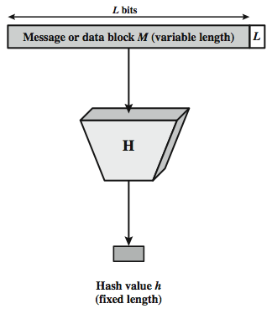
Cryptographic Hash Function
Notes:
Stallings Figure 11.1 depicts the general operation of a cryptographic hash function. Typically, the input is padded out to an integer multiple of some fixed length (e.g., 1024 bits) and the padding includes the value of the length of the original message in bits. The length field is a security measure to increase the difficulty for an attacker to produce an alternative message with the same hash value.

Slide 51
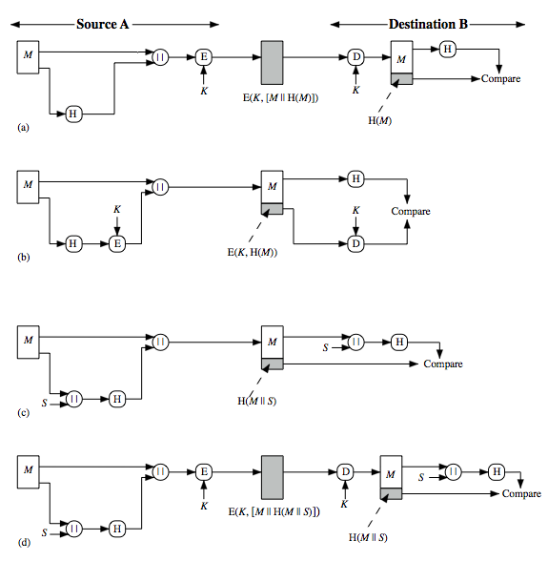
Hash Functions & Message Authent-ication
Notes:
Message authentication is a mechanism or service used to verify the integrity of a message, by assuring that the data received are exactly as sent. Hash code can be used to provide message authentication, as follows:
The message plus concatenated hash code is encrypted using symmetric encryption. Since only A and B share the secret key, the message must have come from A and has not been altered. The hash code provides the structure or redundancy required to achieve authentication.
Only the hash code is encrypted, using symmetric encryption. This reduces the processing burden for those applications not requiring confidentiality.
Shows the use of a hash function but no encryption for message authentication. The technique assumes that the two communicating parties share a common secret value S. A computes the hash value over the concatenation of M and S and appends the resulting hash value to M. Because B possesses S, it can recompute the hash value to verify. Because the secret value itself is not sent, an opponent cannot modify an intercepted message and cannot generate a false message.
Confidentiality can be added to the approach of (c) by encrypting the entire message plus the hash code.
When confidentiality is not required, method (b) has an advantage over methods (a) and (d), which encrypts the entire message, in that less computation is required.

Slide 52
Message authentication is a mechanism or service used to verify the integrity of a message, by assuring that the data received are exactly as sent. Stallings Figure 11.2 illustrates a variety of ways in which a hash code can be used to provide message authentication, as follows:
The message plus concatenated hash code is encrypted using symmetric encryption. Since only A and B share the secret key, the message must have come from A and has not been altered. The hash code provides the structure or redundancy required to achieve authentication.
Only the hash code is encrypted, using symmetric encryption. This reduces the processing burden for those applications not requiring confidentiality.

Slide 53
c. Shows the use of a hash function but no encryption for message authentication. The technique assumes that the two communicating parties share a common secret value S. A computes the hash value over the concatenation of M and S and appends the resulting hash value to M. Because B possesses S, it can recompute the hash value to verify. Because the secret value itself is not sent, an opponent cannot modify an intercepted message and cannot generate a false message.
d.Confidentiality can be added to the approach of (c) by encrypting the entire message plus the hash code.
When confidentiality is not required, method (b) has an advantage over methods (a) and (d), which encrypts the entire message, in that less computation is required.

Slide 54
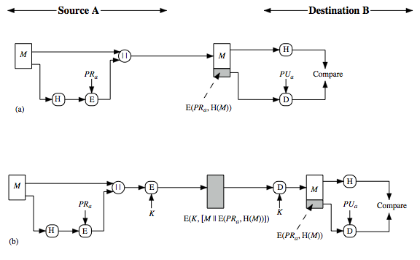
Hash Functions & Digital Signatures
Notes:
Another important application, which is similar to the message authentication application, is the digital signature. The operation of the digital signature is similar to that of the MAC. In the case of the digital signature, the hash value of a message is encrypted with a user's private key. Anyone who knows the user's public key can verify the integrity of the message that is associated with the digital signature. In this case an attacker who wishes to alter the message would need to know the user's private key. As we shall see in Chapter 14, the implications of digital signatures go beyond just message authentication. Stallings Figure 11.3 illustrates, in a simplified fashion, how a hash code is used to provide a digital signature:
The hash code is encrypted, using public-key encryption and using the sender's private key. As with Figure 11.2b, this provides authentication. It also provides a digital signature, because only the sender could have produced the encrypted hash code. In fact, this is the essence of the digital signature technique.
If confidentiality as well as a digital signature is desired, then the message plus the private-key-encrypted hash code can be encrypted using a symmetric secret key. This is a common technique.

Slide 55
Another important application, which is similar to the message authentication application, is the digital signature. The operation of the digital signature is similar to that of the MAC.
In the case of the digital signature, the hash value of a message is encrypted with a user's private key. Anyone who knows the user's public key can verify the integrity of the message that is associated with the digital signature. In this case an attacker who wishes to alter the message would need to know the user's private key.
The hash code is encrypted, using public-key encryption and using the sender's private key. As with Figure 11.2b, this provides authentication. It also provides a digital signature, because only the sender could have produced the encrypted hash code. In fact, this is the essence of the digital signature technique.
If confidentiality as well as a digital signature is desired, then the message plus the private-key-encrypted hash code can be encrypted using a symmetric secret key. This is a common technique.

Slide 56
Other Hash Function Uses
to create a one-way password file
  store hash of password not actual password
for intrusion detection and virus detection
  keep & check hash of files on system
pseudorandom function (PRF) or pseudorandom number generator (PRNG)
Notes:
Hash functions are commonly used to create a one-way password file. Chapter 20 explains a scheme in which a hash of a password is stored by an operating system rather than the password itself. Thus, the actual password is not retrievable by a hacker who gains access to the password file. In simple terms, when a user enters a password, the hash of that password is compared to the stored hash value for verification. This approach to password protection is used by most operating systems.
Hash functions can be used for intrusion detection and virus detection. Store H(F) for each file on a system and secure the hash values (e.g., on a CD-R that is kept secure). One can later determine if a file has been modified by recomputing H(F). An intruder would need to change F without changing H(F).
A cryptographic hash function can be used to construct a pseudorandom function (PRF) or a pseudorandom number generator (PRNG). A common application for a hash-based PRF is for the generation of symmetric keys. We discuss this application in Chapter 12.

Slide 57
Two Simple Insecure Hash Functions
consider two simple insecure hash functions
bit-by-bit exclusive-OR (XOR) of every block
  C_{i} = b_{i1} xor b_{i2} xor . . . xor b_{im}
  a longitudinal redundancy check
  reasonably effective as data integrity check
one-bit circular shift on hash value
  for each successive n-bit block
    rotate current hash value to left by1bit and XOR block
  good for data integrity but useless for security
Notes:
To get some feel for the security considerations involved in cryptographic hash functions, we present two simple, insecure hash functions in this section. One of the simplest hash functions is the bit-by-bit exclusive-OR (XOR) of every block, which can be expressed as shown. This operation produces a simple parity for each bit position and is known as a longitudinal redundancy check. It is reasonably effective for random data as a data integrity check. Each n-bit hash value is equally likely. Thus, the probability that a data error will result in an unchanged hash value is 2^{–n}. With more predictably formatted data, the function is less effective. For example, in most normal text files, the high-order bit of each octet is always zero. So if a 128-bit hash value is used, instead of an effectiveness of 2^{–128}, the hash function on this type of data has an effectiveness of 2^{–112}.
A simple way to improve matters is to perform a one-bit circular shift, or rotation, on the hash value after each block is processed. Although this second procedure provides a good measure of data integrity, it is virtually useless for data security when an encrypted hash code is used with a plaintext message. Given a message, it is an easy matter to produce a new message that yields that hash code: Simply prepare the desired alternate message and then append an n-bit block that forces the new message plus block to yield the desired hash code.

Slide 58
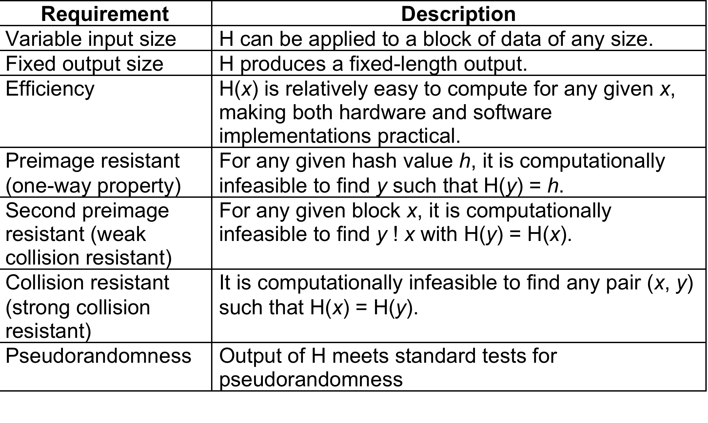
Hash Function Requirements
Notes:
Stallings Table 11.1 lists the generally accepted requirements for a cryptographic hash function. The first three properties are requirements for the practical application of a hash function. The fourth property, preimage (for a hash value h = H(x), we say that x is the preimage of h) resistant, is the one-way property: it is easy to generate a code given a message, but virtually impossible to generate a message given a code. This property is important if the authentication technique involves the use of a secret value (Figure 11.2c). The fifth property, second preimage resistant, guarantees that it is impossible to find an alternative message with the same hash value as a given message. This prevents forgery when an encrypted hash code is used (Figure 11.2b and Figure 11.3a). A hash function that satisfies the first five properties in Table 11.1 is referred to as a weak hash function. If the sixth property, collision resistant, is also satisfied, then it is referred to as a strong hash function. A strong hash function protects against an attack in which one party generates a message for another party to sign. The final requirement, pseudorandomness, has not traditionally been listed as a requirement of cryptographic hash functions, but is more or less implied.

Slide 59
Attacks on Hash Functions
have brute-force attacks and cryptanalysis
a preimage or second preimage attack
  find y s.t. H(y) equals a given hash value
collision resistance
  find two messages x & y with same hash so H(x) = H(y)
hence value 2^{m/2} determines strength of hash code against brute-force attacks
  128-bits inadequate, 160-bits suspect
Notes:
As with encryption algorithms, there are two categories of attacks on hash functions: brute-force attacks and cryptanalysis. A brute-force attack does not depend on the specific algorithm but depends only on bit length. In the case of a hash function, a brute-force attack depends only on the bit length of the hash value. A cryptanalysis, in contrast, is an attack based on weaknesses in a particular cryptographic algorithm.
For a preimage or second preimage attack, an adversary wishes to find a value y such that H(y) is equal to a given hash value h. The brute force method is to pick values of y at random and try each value until a collision occurs. For an m-bit hash value, the level of effort is proportional to 2^{m}. Specifically, the adversary would have to try, on average, 2^{m–1} values of y to find one that generates a given hash value h.
For a collision resistant attack, an adversary wishes to find two messages or data blocks, x and y, that yield the same hash function: H(x) = H(y). This requires much less effort than a preimage or second preimage attack. The effort required is explained by a mathematical result referred to as the birthday paradox (next slide).
If collision resistance is required, then the value 2^{m/2} determines the strength of the hash code against brute-force attacks. Van Oorschot and Wiener presented a design for a $10 million collision search machine for MD5, which has a 128-bit hash length, that could find a collision in 24 days. Thus a 128-bit code may be viewed as inadequate. The next step up, if a hash code is treated as a sequence of 32 bits, is a 160-bit hash length. With a hash length of 160 bits, the same search machine would require over four thousand years to find a collision. With today's technology, the time would be much shorter, so that 160 bits now appears suspect.

Slide 60
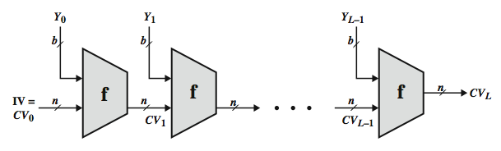
Hash Function Cryptanalysis
cryptanalytic attacks exploit some property of alg so faster than exhaustive search
hash functions use iterative structure
  process message in blocks (incl length)
attacks focus on collisions in function f
Notes:
As with encryption algorithms, cryptanalytic attacks on hash functions seek to exploit some property of the algorithm to perform some attack other than an exhaustive search. In recent years, have much effort, and some successes, in developing cryptanalytic attacks on hash functions. Must consider the overall structure of a typical secure hash function, referred to as an iterated hash function, as indicated in Stallings Figure 11.7. This was proposed by Merkle and is the structure of most hash functions in use today. The hash function takes an input message and partitions it into L fixed-sized blocks of b bits each. If necessary, the final block is padded to b bits. The final block also includes the value of the total length of the input to the hash function. The inclusion of the length makes the job of the opponent more difficult. The hash algorithm involves repeated use of a compression function, f, that takes two inputs (an n-bit input from the previous step, called the chaining variable, and a b-bit block) and produces an n-bit output. At the start of hashing, the chaining variable has an initial value that is specified as part of the algorithm. The final value of the chaining variable is the hash value. Often, b > n; hence the term compression. The motivation for this iterative structure stems from the observation by Merkle and Damgard that if the compression function is collision resistant, then so is the resultant iterated hash function. Therefore, the structure can be used to produce a secure hash function to operate on a message of any length. Cryptanalysis of hash functions focuses on the internal structure of f and is based on attempts to find efficient techniques for producing collisions for a single execution of f. Once that is done, the attack must take into account the fixed value of IV. The attack on f depends on exploiting its internal structure. The attacks that have been mounted on hash functions are rather complex and beyond our scope here.

Slide 61
Secure Hash Algorithm
SHA originally designed by NIST & NSA in 1993
was revised in 1995 as SHA-1
US standard for use with DSA signature scheme
  standard is FIPS 180-1 1995, also Internet RFC3174
  nb. the algorithm is SHA, the standard is SHS
based on design of MD4 with key differences
produces 160-bit hash values
recent 2005 results on security of SHA-1 have raised concerns on its use in future applications
Notes:
In recent years, the most widely used hash function has been the Secure Hash Algorithm (SHA). The Secure Hash Algorithm (SHA) was developed by the National Institute of Standards and Technology (NIST) and published as a federal information processing standard (FIPS 180) in 1993; a revised version was issued as FIPS 180-1 in 1995 and is generally referred to as SHA-1. The actual standards document is entitled Secure Hash Standard. SHA is based on the hash function MD4 and its design closely models MD4. SHA-1 produces a hash value of 160 bits. In 2005, a research team described an attack in which two separate messages could be found that deliver the same SHA-1 hash using 2^69 operations, far fewer than the 2^80 operations previously thought needed to find a collision with an SHA-1 hash [WANG05]. This result has hastened the transition to newer, longer versions of SHA.

Slide 62
Revised Secure Hash Standard
NIST issued revision FIPS 180-2 in 2002
adds 3 additional versions of SHA
  SHA-256, SHA-384, SHA-512
designed for compatibility with increased security provided by the AES cipher
structure & detail is similar to SHA-1
hence analysis should be similar
but security levels are rather higher
Notes:
In 2002, NIST produced a revised version of the standard, FIPS 180-2, that defined three new versions of SHA, with hash value lengths of 256, 384, and 512 bits, known as SHA-256, SHA-384, and SHA-512. Collectively, these hash algorithms are known as SHA-2. These new versions have the same underlying structure and use the same types of modular arithmetic and logical binary operations as SHA-1, hence analyses should be similar. A revised document was issued as FIP PUB 180-3 in 2008, which added a 224-bit version. SHA-2 is also specified in RFC 4634, which essentially duplicates the material in FIPS 180-3, but adds a C code implementation.
In 2005, NIST announced the intention to phase out approval of SHA-1 and move to a reliance on the other SHA versions by 2010.

Slide 63

SHA Versions
Notes:
Stallings Table 11.3 provides a comparison of the various parameters for the SHA hash functions.

Slide 64
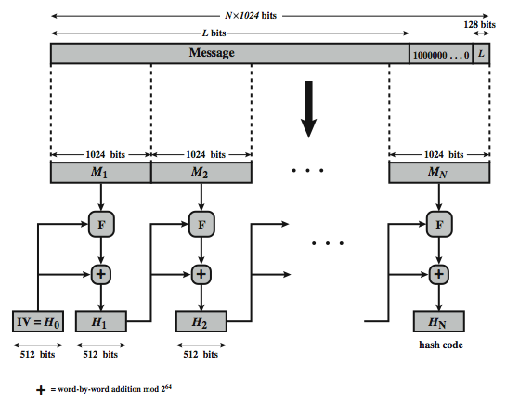
SHA-512 Overview
Notes:
Now examine the structure of SHA-512, noting that the other versions are quite similar.
SHA-512 follows the structure depicted in Stallings Figure 11.8. The processing consists of the following steps:
• Step 1: Append padding bits, consists of a single 1-bit followed by the necessary number of 0-bits, so that its length is congruent to 896 modulo 1024
• Step 2: Append length as an (big-endian) unsigned 128-bit integer
• Step 3: Initialize hash buffer to a set of 64-bit integer constants (see text)
• Step 4: Process the message in 1024-bit (128-word) blocks, which forms the heart of the algorithm. Each round takes as input the 512-bit buffer value H_{i}, and updates the contents of that buffer.
• Step 5: Output the final state value as the resulting hash
See text for more details.

Slide 65
Now examine the structure of SHA-512, noting that the other versions are quite similar.
SHA-512 follows the structure depicted in Stallings Figure 11.8. The processing consists of the following steps:
• Step 1: Append padding bits, consists of a single 1-bit followed by the necessary number of 0-bits, so that its length is congruent to 896 modulo 1024
• Step 2: Append length as an (big-endian) unsigned 128-bit integer
• Step 3: Initialize hash buffer to a set of 64-bit integer constants (see text)
• Step 4: Process the message in 1024-bit (128-word) blocks, which forms the heart of the algorithm. Each round takes as input the 512-bit buffer value H_{i}, and updates the contents of that buffer.
• Step 5: Output the final state value as the resulting hash
See text for more details.

Slide 66
SHA-512 Compression Function
heart of the algorithm
processing message in 1024-bit blocks
consists of 80 rounds
  updating a 512-bit buffer
  using a 64-bit value Wt derived from the current message block
  and a round constant based on cube root of first 80 prime numbers
Notes:
The SHA-512 Compression Function is the heart of the algorithm. In this Step 4, it processes the message in 1024-bit (128-word) blocks, using a module that consists of 80 rounds, labeled F in Stallings Figure 11.8, and is shown in detail in Figure 11.9. Each round takes as input the 512-bit buffer value, and updates the contents of the buffer. At input to the first round, the buffer has the value of the intermediate hash value. Each round t makes use of a 64-bit value Wt derived using a message schedule from the current 1024-bit block being processed. Each round also makes use of an additive constant Kt, based on the fractional parts of the cube roots of the first eighty prime numbers. The constants provide a “randomized” set of 64-bit patterns, which should eliminate any regularities in the input data. The output of the eightieth round is added to the input to the first round to produce the final hash value for this message block, which forms the input to the next iteration of this compression function, as shown on the previous slide.

Slide 67
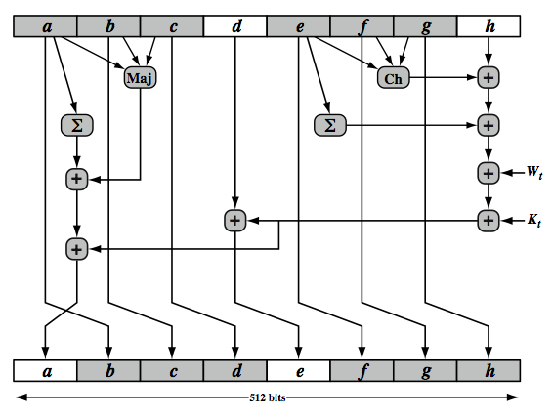
SHA-512 Round Function
Notes:
The structure of each of the 80 rounds is shown in Stallings Figure 11.10. Each 64-bit word is shuffled along one place, and in some cases manipulated using a series of simple logical functions (ANDs, NOTs, ORs, XORs, ROTates), in order to provide the avalanche & completeness properties of the hash function. The elements are:
Ch(e,f,g) = (e AND f) XOR (NOT e AND g)
Maj(a,b,c) = (a AND b) XOR (a AND c) XOR (b AND c)
∑(a) = ROTR(a,28) XOR ROTR(a,34) XOR ROTR(a,39)
∑(e) = ROTR(e,14) XOR ROTR(e,18) XOR ROTR(e,41)
+ = addition modulo 2^64
Kt = a 64-bit additive constant
Wt = a 64-bit word derived from the current 512-bit input block.
Six of the eight words of the output of the round function involve simply permutation (b, c, d, f, g, h) by means of rotation. This is indicated by shading in Figure 11.10. Only two of the output words (a, e) are generated by substitution. Word e is a function of input variables d, e, f, g, h, as well as the round word W t and the constant Kt. Word a is a function of all of the input variables, as well as the round word W t and the constant Kt.

Slide 68
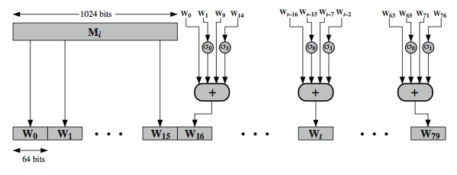
SHA-512 Round Function
Notes:
Stallings Figure 11.11 illustrates how the 64-bit word values Wt are derived from the 1024-bit message. The first 16 values of Wt are taken directly from the 16 words of the current block. The remaining values are defined as a function of the earlier values using ROTates, SHIFTs and XORs as shown. The function elements are:
∂0(x) = ROTR(x,1) XOR ROTR(x,8) XOR SHR(x,7)
∂1(x) = ROTR(x,19) XOR ROTR(x,61) XOR SHR(x,6)
Thus, in the first 16 steps of processing, the value of W_{t} is equal to the corresponding word in the message block. For the remaining 64 steps, the value of W_{t} consists of the circular left shift by one bit of the XOR of four of the preceding values of W_{t}, with two of those values subjected to shift and rotate operations. This introduces a great deal of redundancy and interdependence into the message blocks that are compressed, which complicates the task of finding a different message block that maps to the same compression function output.
See text for details of an example based on one in FIPS 180.

